Slide 1

Predictive Modelling Conclusion
By : Qaidjohar Dama

Slide 2
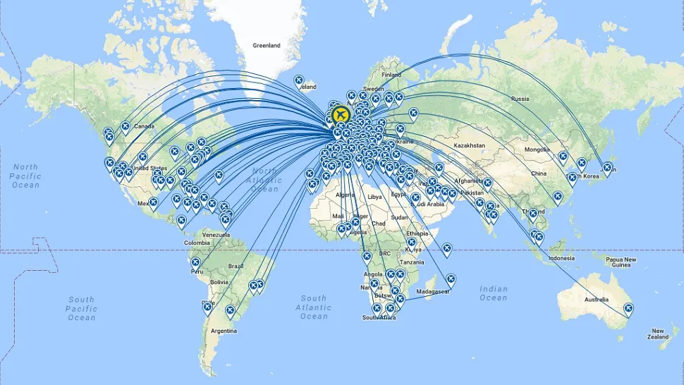
British Airways Global Reach
British Airways serves passengers traveling to 103 countries worldwide. However, there is one country listed as "(not set)" indicating incomplete information. Passengers have booked flights to various destinations, including popular tourist destinations like New Zealand, India, and the United Kingdom, as well as business hubs like China, Singapore, and the United States. Notably, some countries like Myanmar (Burma) and Svalbard & Jan Mayen represent more remote or less frequently traveled destinations. The airline's extensive network covers diverse regions, catering to both leisure and business travelers across the globe.

Slide 3
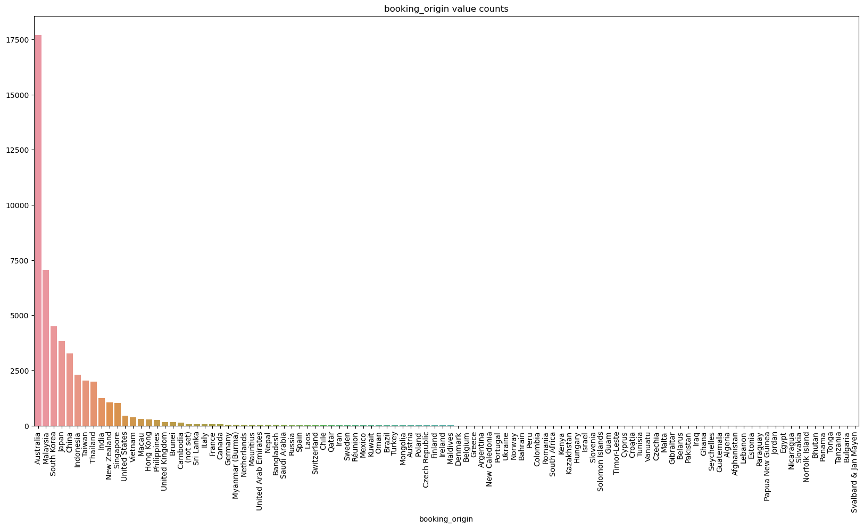
Booking Distribution Overview
Among the countries by booking count, Australia has the highest share with 17500, followed by Malaysia 7400, and South Korea 4980. Japan and China also represent significant portions with 4200 and 3800 respectively, while the remaining countries contribute smaller percentages to the total bookings.

Slide 4
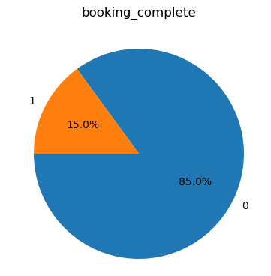
Booking Status Overview
total booking entries
49252
completed bookings
7384
There are a total of 49,252 booking entries in the system.
This figure encompasses all bookings recorded in the database.
In total, 7384 bookings have been successfully completed across all entries, representing 15% of the total completed bookings
uncompleted bookings
41868
In total, 41,868 bookings remain uncompleted across all entries, constituting 85% of the total completed bookings
Out of 49263 booking entries only 15 % bookings completed.

Slide 5
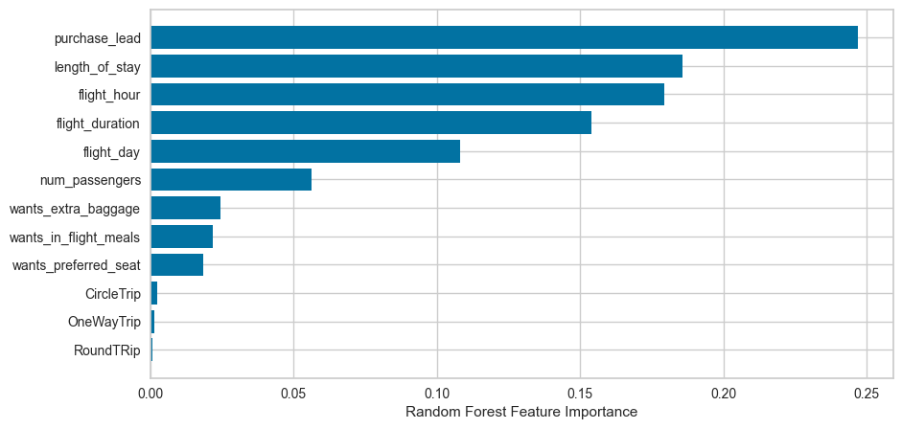
Predictive modelling results
Recall Rate
84%
Precision
79%
Chance of predicting true successful bookings.
Will be predicted as actually completed bookings out of all successfully completed bookings.
Accuracy of the model predicting successful or incomplete booking is
Accuracy
78%
We are concerned with not predicting the successful bookings correctly. Imbalance dataset drives higher accuracy but it does not accurately predict the successful bookings.
Top features that can drive successful flight bookings.

